Slide 1


Linux Practical Lab

Slide 2
Topics
Introduction to Linux
Linux directory structure
Basic Commands
Vim Editor
Hard link & Soft link
File Compression and Extraction
Creating Users and Groups
About Sudo
Creating Files and giving permissions
Filter and I/O Commands
Server Connection
Package Installation
Web Server and Application Server
Package deployment
ACLs
Crontab
Job Scheduling

Slide 3
1.Introduction to Linux
What is Linux?
Linux® is an open source operating system (OS). An operating system is the software that directly manages a system’s hardware and resources, like CPU, memory, and storage. The OS sits between applications and hardware and makes the connections between all of your software and the physical resources that do the work.

Slide 4
What is Open Source ?
Linux is a free, open source operating system, released under the General Public License (GPL). Anyone can run, study, modify, and redistribute the source code, or even sell copies of their modified code, as long as they do so under the same license.

Slide 5
Why Linux?
Open source
Security
Stability
Community support
Free
DevOps most of the tools implements on Linux only
Automation
Customizable
Reliability
Runs on any hardware

Slide 6
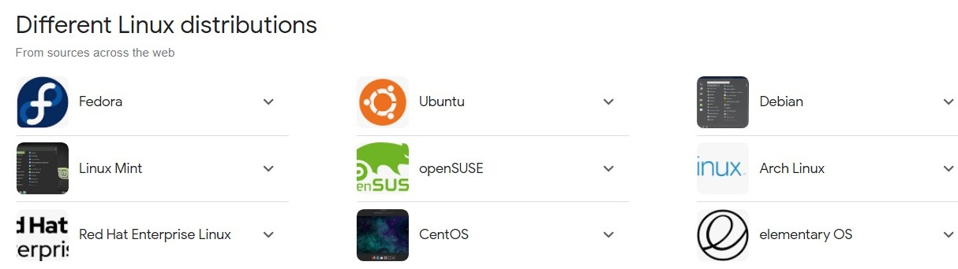
Different Linux distributions ?

Slide 7
Most used Linux distros currently in IT industry ?
RPM based:- RHEL & Centos
Debian based :- Ubuntu Server

Slide 8
What is difference between RPM based and Debian based ?
DEB automatically installs dependencies using APT, while RPM automatically installs dependencies using YUM.
DEB uses Debian Package Repositories, while RPM uses RPM Package Manager Repositories.
Largely, the choice between DEB and RPM depends on your choice of Linux distribution.

Slide 9
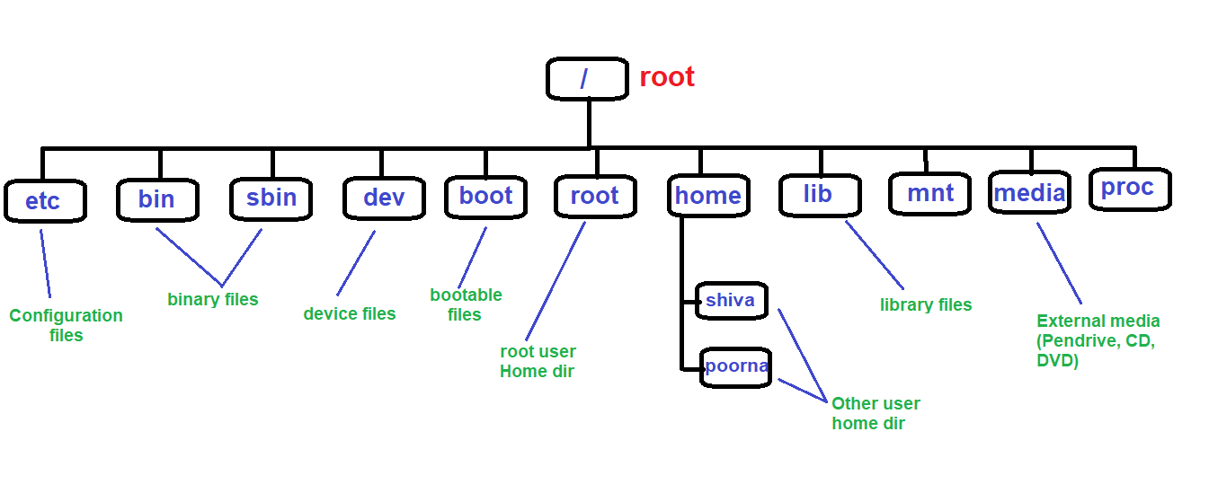
2. Linux directory structure

Slide 10
1. / – Root: Every single file and directory starts from the root directory. Only root user has write privilege under this directory.
2. /etc: Configuration Files, Contains configuration files required by all programs.
3. bin: User Binaries, Contains binary executables.
4. sbin: Just like /bin, /sbin also contains binary executables.
5. dev: Contains device files. These include terminal devices, usb, or any device attached to the system.
6. boot: Contains boot loader related files.
7. lib: Contains library files that supports the binaries located under /bin and /sbin
8. mnt: Temporary mount directory where sysadmins can mount filesystems.
9. media: For examples, /media/cdrom for CD-ROM; /media/floppy for floppy drives; /media/cdrecorder for CD writer
10. proc: Contains information about system process.

